Slide 1

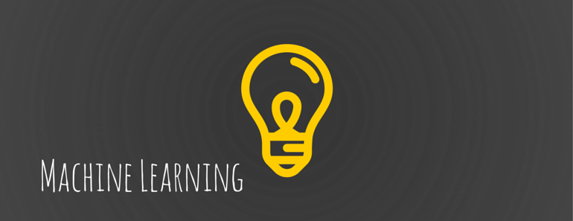
Productising ML Models
Priya Basker
September 2019

Slide 2
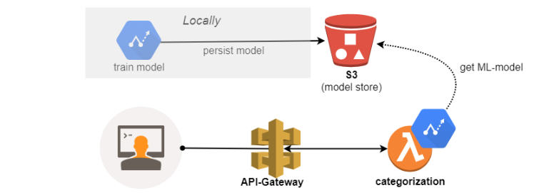
Architectural diagram

Slide 3
AWS Components
1. S3 bucket
2. API Gateway
3. Lambdas
4. HTML Frontend

Slide 4
Steps involved
Train
Train a model in a notebook
Store
Store the model in byte stream format, save python object in pickle format
Create
Create S3 bucket
Upload
Upload pickled model in lambda in s3
Link
Link Api to pass the parameters by POST function
View
View and send request from frontend

Slide 5
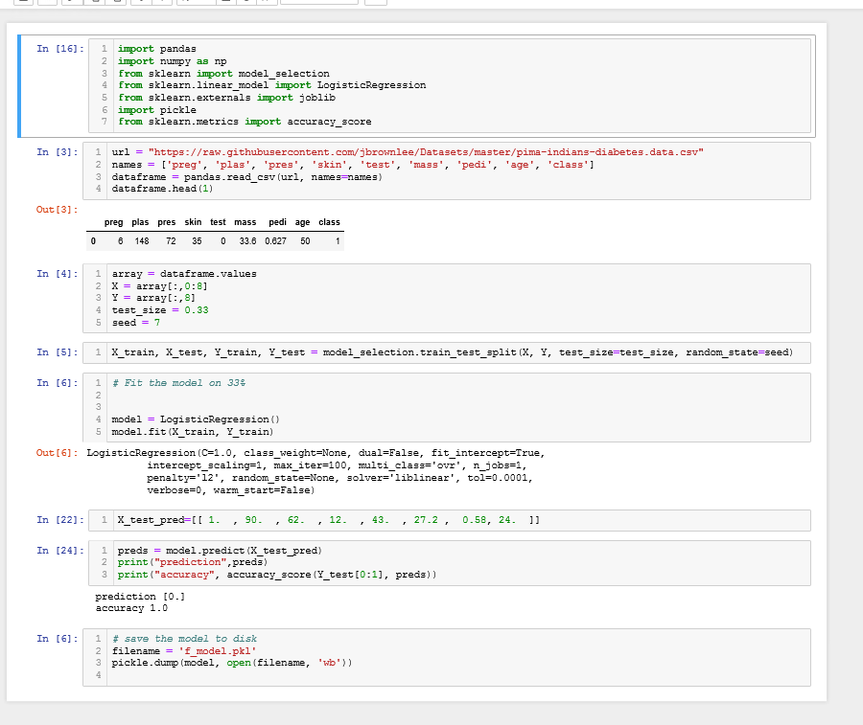
Model

Slide 6
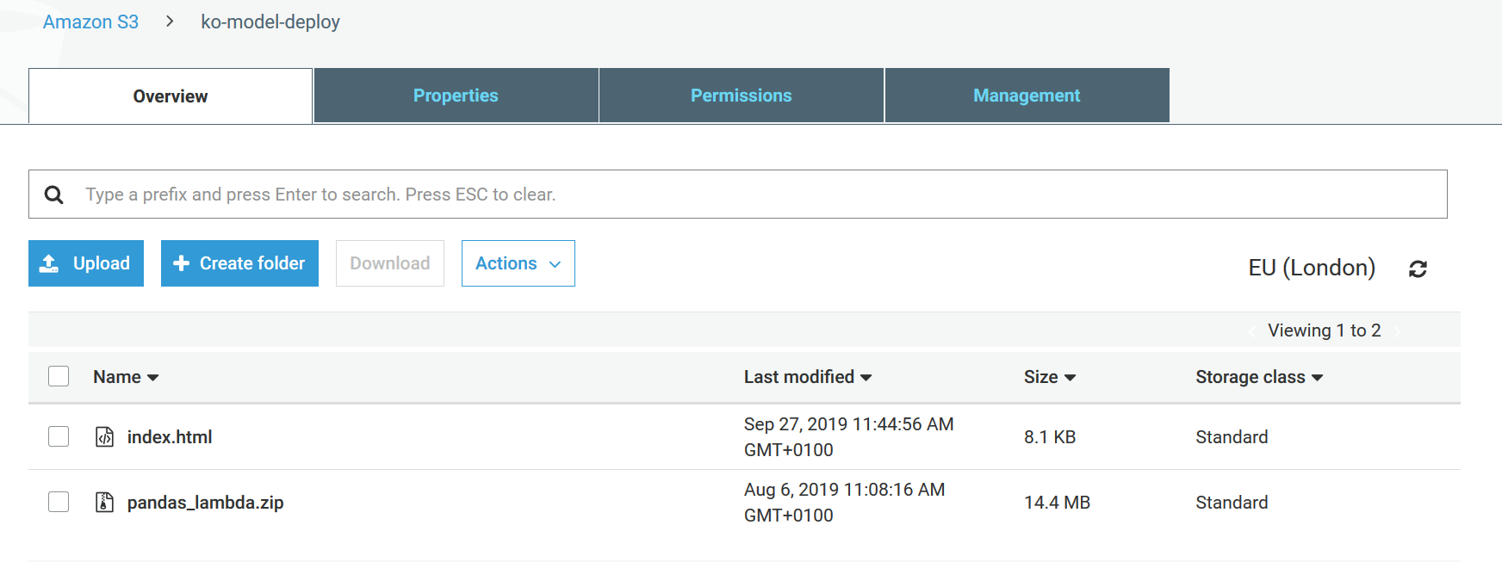
S3 Bucket

Slide 7
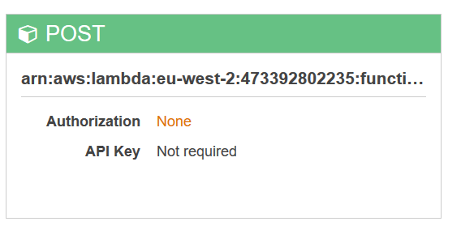
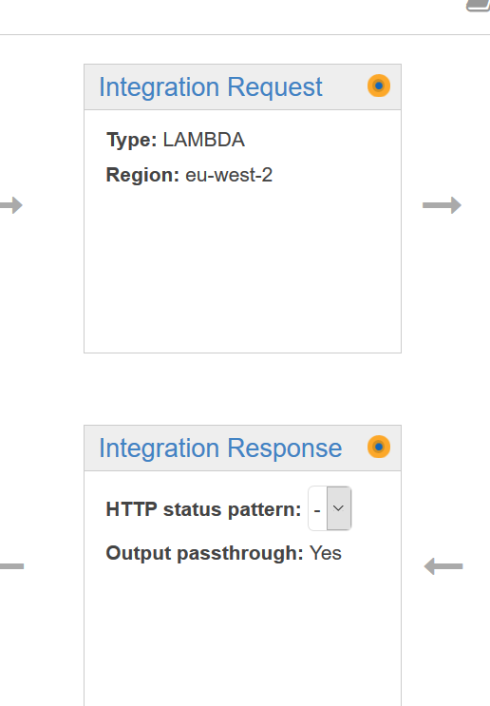
API Gateway

Slide 8
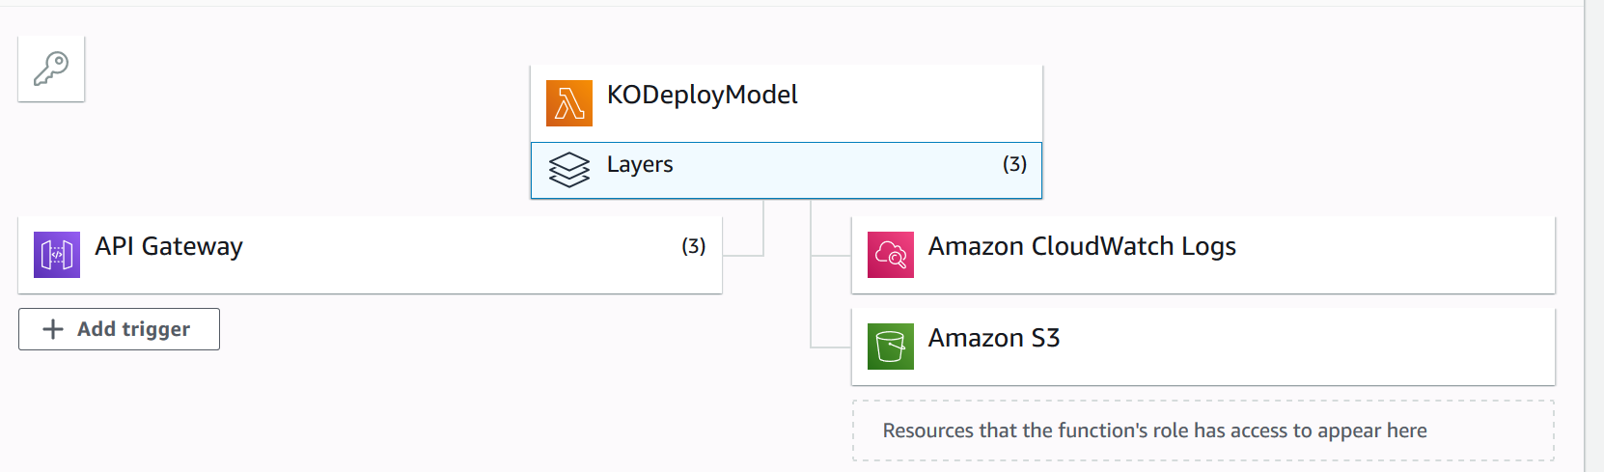
Lambda and Layers

Slide 9
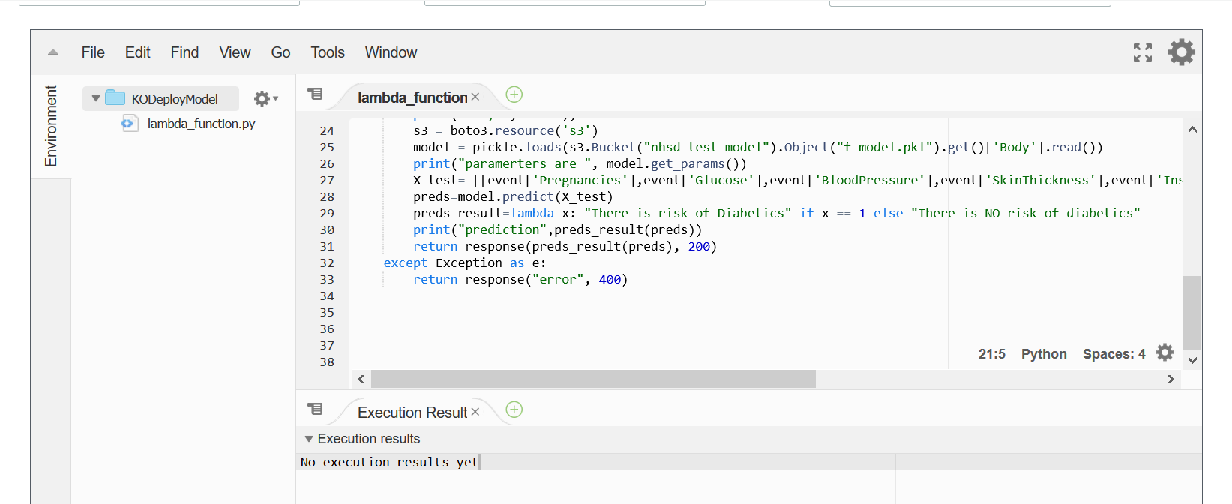
Lambda Code

Slide 10
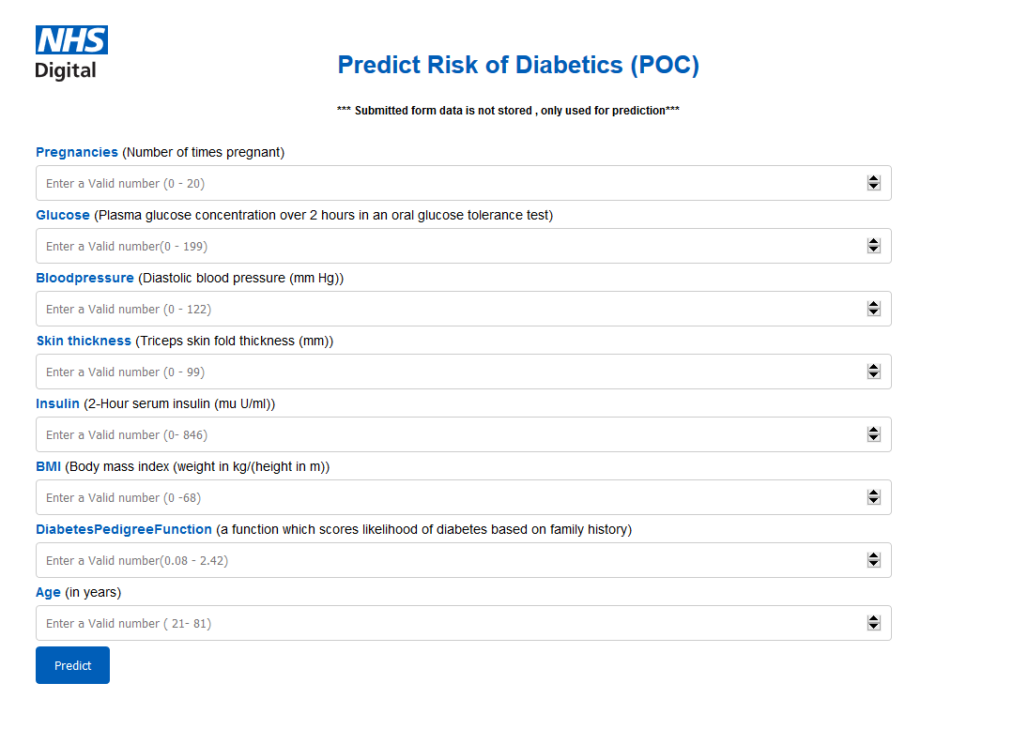
Working HTML front end
https://ko-model-deploy.s3.eu-west-2.amazonaws.com/index.html

Slide 11
Next Steps
1. Create a Secure User Login using Cloud front
2. Train the model continuously suing the data entered
3. Deploy bigger model with libraries in Layers
4. Try Sage Maker !!

